Slide 1
Chapter 9: Real-Time Facilities

Slide 2
Aims
To understand the role that time has in the design and implementation of real-time systems
To introduce the real-time systems notion of time
To illustrate how clocks are handled in Ada, Real-Time Java and POSIX
To illustrate how delays and timeouts are handled in Ada, Real-Time Java and POSIX
To consider how timing requirements can be specified using temporal scopes

Slide 3
Requirements
Interfacing with time
  accessing clocks so that the passage of time can be measured
  delaying processes until some future time
  programming timeouts so that the non-occurrence of some event can be recognized and dealt with
Representing timing requirements — see next lecture
  specifying rates of execution
  specifying deadlines
Satisfying timing requirements — covered later

Slide 4
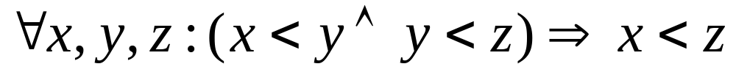
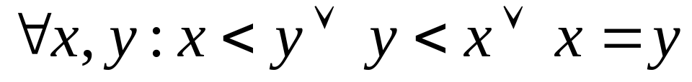
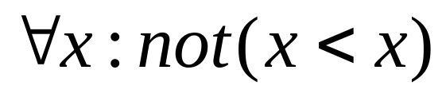
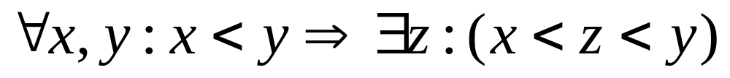
A Notion of Time
Transitivity:
Linearity:
Irreflexivity:
Density:

Slide 5
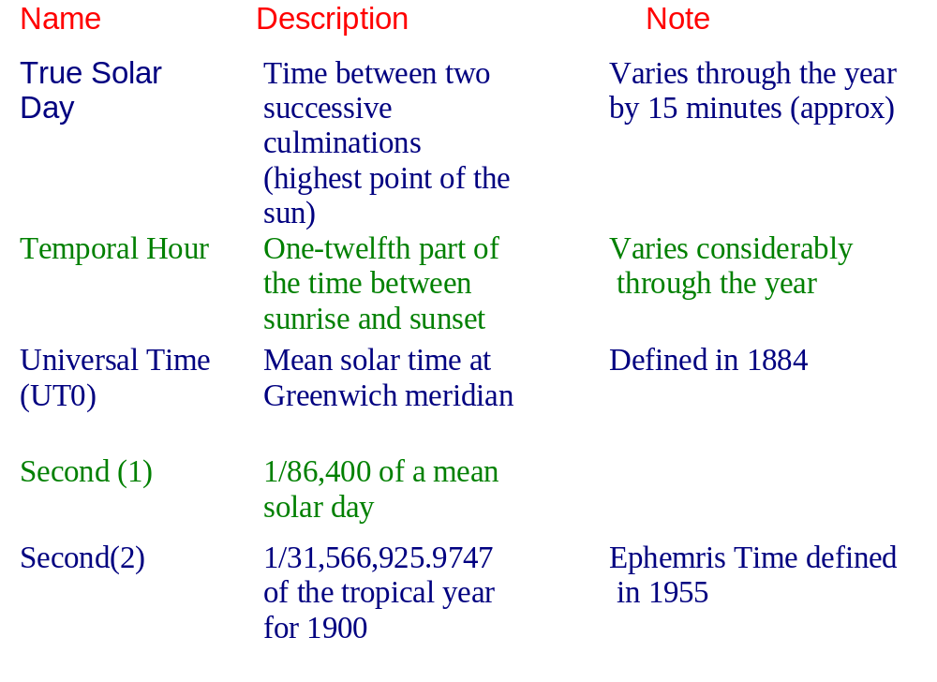
Standard Time

Slide 6
correction to UTO because of
polar motion
UT1
UT2
Correction of UT1 because of variation in the speed of rotation of the earth
Duration of 9_192_631_770 periods of the radiation corresponding to the
transition between two hyperfine levels of the ground state of the Caesium - 133 atom
Accuracy of current Caesium atomic clocks deemed to be one part of 10^13
(that is, one clock error per 300,000 years)
Seconds(3)
International Atomic Time (IAT)
Based upon Caesium atomic clock
Maximum difference between UT2 (which is based on astrological measurement) and IAT (which is based upon atomic measurements) is kept to below 0.5 seconds
Coordinated Universal Time (UTC)
An IAT clock synchronized to UT2 by the addition of occasional leap ticks

Slide 7
Access to a Clock
by having direct access to the environment's time frame (e.g. GPS also provides a UTC service)
by using an internal hardware clock that gives an adequate approximation to the passage of time in the environment

Slide 8
Calendar
package Ada.Calendar is
type Time is private;
subtype Year_Number is Integer range 1901..2099;
subtype Month_Number is Integer range 1..12;
subtype Day_Number is Integer range 1..31;
subtype Day_Duration is Duration range 0.0..86_400.0;
function Clock return Time;

Slide 9
Calendar II
function Year(Date:Time) return Year_Number;
function Month(Date:Time) return Month_Number;
function Day(Date:Time) return Day_Number;
function Seconds(Date:Time) return Day_Duration;
procedure Split(Date:in Time; Year:out Year_Number;
Month:out Month_Number; Day:out Day_Number;
Seconds:out Day_Duration);
function Time_Of(Year:Year_Number; Month:Month_Number;
Day:Day_Number; Seconds:Day_Duration := 0.0) return Time;

Slide 10
Calendar III
function "+"(Left:Time; Right:Duration) return Time;
function "+"(Left:Duration; Right:Time) return Time;
function "-"(Left:Time; Right:Duration) return Time;
function "-"(Left:Time; Right:Time) return Duration;
function "<"(Left,Right:Time) return Boolean;
// similarly for "<=“,">“, ">="
Time_Error:exception;
-- Time_Error may be raised by Time_Of,
-- Split, Year, "+" and "-"
private
implementation-dependent
end Ada.Calendar;

Slide 11
Calendar IV
A value of the private type Time is a combination of the date and the time of day
The time of day is given in seconds from midnight
Seconds are described in terms of a subtype Day_Duration
Which is, in turn, defined by means of Duration
Time base is implementation-defined
No requirement to be synchronized with UTC

Slide 12
Duration
This fixed point type Duration is one of the predefined scalar types and has a range which, although implementation dependent, must be at least -86_400.0 .. +86_400.0
The value 86_400 is the number of seconds in a day
The accuracy of Duration is also implementation dependent but the smallest representable value Duration'Small must not be greater than 20 milliseconds
It is recommended in the ARM that it is no greater than 100 microseconds

Slide 13
Example Use
declare
Old_Time, New_Time : Time;
Interval : Duration;
begin
Old_Time := Clock;
-- other computations
New_Time := Clock;
Interval := New_Time - Old_Time;
end;
The other language clock is provided by the optional package Real_Time
This has a similar form to Calendar but is intended to give a finer granularity

Slide 14
Real-Time Clock
package Ada.Real_Time is
type Time is private;
Time_First: constant Time;
Time_Last: constant Time;
Time_Unit: constant := implementation_defined_real_number;
type Time_Span is private;
Time_Span_First: constant Time_Span;
Time_Span_Last: constant Time_Span;
Time_Span_Zero: constant Time_Span;
Time_Span_Unit: constant Time_Span;
Tick: constant Time_Span;
function Clock return Time;

Slide 15
Real-Time Clock II
function "+" (Left: Time; Right: Time_Span) return Time;
function "+" (Left: Time_Span; Right: Time) return Time;
-- similarly for "-", "<",etc
function To_Duration(TS: Time_Span) return Duration;
function To_Time_Span(D: Duration) return Time_Span;

Slide 16
Real-Time Clock III
function Nanoseconds (NS: Integer) return Time_Span;
function Microseconds(US: Integer) return Time_Span;
function Milliseconds(MS: Integer) return Time_Span;
type Seconds_Count is range implementation-defined;
procedure Split(T : in Time; SC: out Seconds_Count;
TS : out Time_Span);
function Time_Of(SC: Seconds_Count;
TS: Time_Span) return Time;
private
-- not specified by the language
end Ada.Real_Time;

Slide 17
Metrics
Time_Unit is the smallest amount of real time representable by the Time type
The value of Tick must be no greater than 1 millisecond
The range of Time (from the epoch that represents the program's start-up) must be at least 50 years
Other important features of this time abstraction are described in the Real-Time Annex

Slide 18
Example: Timing a Sequence
declare
use Ada.Real_Time;
Start, Finish : Time;
Interval : Time_Span := To_Time_Span(1.7);
begin
Start := Clock;
-- sequence of statements
Finish := Clock;
if Finish - Start > Interval then
raise Time_Error; -- a user-defined exception
end if;
end;

Slide 19
Clocks in Real-Time Java
Similar to those in Ada
java.lang.System.currentTimeMillis returns the number of milliseconds since 1/1/1970 GMT and is used by used by java.util.Date
Real-time Java adds real-time clocks with high resolution time types

Slide 20
RT Java Time Types
public abstract class HighResolutionTime implements
java.lang.Comparable
{
public abstract AbsoluteTime absolute(Clock clock,
AbsoluteTime destination);
...
public boolean equals(HighResolutionTime time);
public final long getMilliseconds();
public final int getNanoseconds();
public void set(HighResolutionTime time);
public void set(long millis);
public void set(long millis, int nanos);
}

Slide 21
public class AbsoluteTime extends HighResolutionTime
{
// various constructor methods including
public AbsoluteTime(AbsoluteTime T);
public AbsoluteTime(long millis, int nanos);
public AbsoluteTime absolute(Clock clock, AbsoluteTime dest);
public AbsoluteTime add(long millis, int nanos);
public final AbsoluteTime add(RelativeTime time);
...
public final RelativeTime subtract(AbsoluteTime time);
public final AbsoluteTime subtract(RelativeTime time);
}

Slide 22
public class RelativeTime extends HighResolutionTime
{
// various constructor methods including
public RelativeTime(long millis, int nanos);
public RelativeTime(RelativeTime time);
public RelativeTime add(long millis, int nanos);
public final RelativeTime add(RelativeTime time);
public final RelativeTime subtract(RelativeTime time);
...
}

Slide 23
RT Java: Clock Class
public abstract class Clock
{
public Clock();
public static Clock getRealtimeClock();
public abstract RelativeTime getResolution();
public AbsoluteTime getTime();
public abstract void getTime(AbsoluteTime time);
public abstract void setResolution(RelativeTime resolution);
}

Slide 24
RT Java: Measuring Time
{
AbsoluteTime oldTime, newTime;
RelativeTime interval;
Clock clock = Clock.getRealtimeClock();
oldTime = clock.getTime();
// other computations
newTime = clock.getTime();
interval = newTime.subtract(oldTime);
}

Slide 25
Clocks in C and POSIX
ANSI C has a standard library for interfacing to “calendar” time
This defines a basic time type time_t and several routines for manipulating objects of type time
Real-time POSIX requires at least one clock of minimum resolution 50 Hz (20ms)

Slide 26
Delaying a Process
In addition to clock access, processes must also be able to delay their execution either for a relative period of time or until some time in the future
Relative delays
  Start := Clock; -- from calendar
  loop
  exit when (Clock - Start) > 10.0;
  end loop;

Slide 27
Delaying a Process
To eliminate the need for these busy-waits, most languages and operating systems provide some form of delay primitive
In Ada, this is a delay statement
  delay 10.0;
Java: sleep; RT Java provides a high resolution sleep

Slide 28
Delays
Granularity difference between clock and delay
Time specified by program
Process executing
Process runnable here but not executing
Interrupts disabled
Time

Slide 29
Absolute Delays
  -- Ada
  START := Clock;
  FIRST_ACTION;
  delay 10.0 - (Clock - START);
  SECOND_ACTION;
Unfortunately, this might not achieve the desired result
  START := Clock;
  FIRST_ACTION;
  delay until START + 10.0;
  SECOND_ACTION;

Slide 30
Absolute Delays
As with delay, delay until is accurate only in its lower bound
RT Java - sleep can be relative or absolute
POSIX requires use of an absolute timer and signals

Slide 31
Drift
The time over-run associated with both relative and absolute delays is called the local drift and it it cannot be eliminated
It is possible, however, to eliminate the cumulative drift that could arise if local drifts were allowed to superimpose

Slide 32
Regular Activity
task T;
task body T is
begin
loop
Action;
delay 7.0;
end loop;
end T;
Cannot delay for less than
7 seconds
local and cumulative drift

Slide 33
Periodic Activity
task body T is
Interval : constant Duration := 7.0;
Next_Time : Time;
begin
Next_Time := Clock + Interval;
loop
Action;
delay until Next_Time;
Next_Time := Next_Time + Interval;
end loop;
end T;
Will run on average
every 7 seconds
local drift only
If Action takes 8 seconds, the delay
statement will have no effect

Slide 34
Programming Timeouts
Timeouts can be added to any condition synchronisation primitive:
  Semaphores
  CCRs
  Condition variables in monitors
  Entries in protected objects
Also on message passing

Slide 35
Message-Passing
task Controller is
entry Call(T : Temperature);
end Controller;
task body Controller is
-- declarations, including
New_Temp : Temperature;
begin
loop
accept Call(T : Temperature) do
New_Temp := T;
end Call;
-- other actions
end loop;
end Controller;

Slide 36
Message-Passing
task Controller is
entry Call(T : Temperature);
end Controller;
task body Controller is
-- declarations
begin
loop
select
accept Call(T : Temperature) do
New_Temp := T;
end Call;
or
delay 10.0;
-- action for timeout
end select;
-- other actions
end loop;
end Controller;

Slide 37
Timeout on Message Send
loop
-- get new temperature T
Controller.Call(T);
end loop;
loop
-- get new temperature T
select
Controller.Call(T);
or
delay 0.5;
null;
end select;
end loop;
select
T.E -- entry E in task T
else
-- other actions
end select;
The null is not strictly needed but shows that again the delay can have
arbitrary statements following,
that are executed if the delay expires before the entry call is accepted

Slide 38
Timeouts and Entries
The above examples have used timeouts on inter-task communication; it is also possible, within Ada, to do timed (and conditional) entry call on protected objects
  select
  P.E ; -- E is an entry in PO P
  or
  delay 0.5;
  end select;

Slide 39
Timeouts on Actions
  select
  delay 0.1;
  then abort
  -- action
  end select;
If the action takes too long, the triggering event will be taken and the action will be aborted
This is clearly an effective way of catching run-away code

Slide 40
Imprecise Computation: Ada
declare
Precise_Result : Boolean;
begin
Completion_Time := ...
-- compulsory part
Results.Write(...); -- call to procedure in
-- external protected object
select
delay until Completion_Time;
Precise_Result := False;
then abort
while Can_Be_Improved loop
-- improve result
Results.Write(...);
end loop;
Precise_Result := True;
end select;
end;

Slide 41
Real-Time Java
With Real-Time Java, timeouts on actions are provided by a subclass of AsynchronouslyInterrupted-Exception called Timed
public class Timed extends AsynchronouslyInterruptedException
implements java.io.Serializable
{
public Timed(HighResolutionTime time) throws
IllegalArgumentException;
public boolean doInterruptible(Interruptible logic);
public void resetTime(HighResolutionTime time);
}

Slide 42
Imprecise Computation
public class PreciseResult
{
public resultType value; // the result
public boolean preciseResult; // indicates if it is imprecise
}
public class ImpreciseComputation {
private HighResolutionTime CompletionTime;
private PreciseResult result = new PreciseResult();
public ImpreciseComputation(HighResolutionTime T)
{
CompletionTime = T; //can be absolute or relative
}
private resultType compulsoryPart()
{
// function which computes the compulsory part
}

Slide 43
public PreciseResult Service() // public service
{
Interruptible I = new Interruptible()
{
public void run(AsynchronouslyInterruptedException exception)
throws AsynchronouslyInterruptedException
{
// this is the optional function which improves on the
// compulsory part
boolean canBeImproved = true;
while(canBeImproved)
{
// improve result
synchronized(this) {
// write result --
// the synchronized statement ensures
// atomicity of the write operation
}
}
result.preciseResult = true;
}

Slide 44
public void interruptAction(
AsynchronouslyInterruptedException exception)
{
result.preciseResult = false;
}
};
Timed t = new Timed(CompletionTime);
result.value = compulsoryPart(); // compute the compulsory part
if(t.doInterruptible(I)) {
// execute the optional part with the timer
return result;
} else { ... };
}
}

Slide 45
Timing Requirements
Work on a more rigorous approach to this aspect of real-time systems has followed two largely distinct paths:
The use of formally defined language semantics and timing requirements, together with notations and logics that enable temporal properties to be represented and analysed
A focus on the performance of real-time systems in terms of the feasibility of scheduling the required work load on the available resources (processors and so on)

Slide 46
Timing Verification
The verification of a real-time system can thus be interpreted as requiring a two stage process:
verifying requirements — given an infinitely fast reliable computer, are the temporal requirements coherent and consistent, that is, have they the potential to be satisfied?
verifying the implementation — with a finite set of (possible unreliable) hardware resources, can the temporal requirements be satisfied?

Slide 47
Temporal Scopes
deadline — the time by which the execution of a TS must be finished
minimum delay — the minimum amount of time that must elapse before the start of execution of a TS
maximum execution time — of a TS
maximum elapse time — of a TS
Temporal scopes with combinations of these attributes are also possible

Slide 48
Now
Minimum delay
a
Deadline
Maximum elapse time
b
Units of execution
c
Maximum execution time = a + b +c

Slide 49
Temporal Scopes
Can be
  Periodic
  Sporadic
  Aperiodic
Deadlines can be:
  Hard
  Soft
  Firm
  Interactive — performance issue

Slide 50
Specifying Tasks and TS
process periodic_P;
...
begin
loop
IDLE
start of temporal scope
...
end of temporal scope
end;
end;
The time constraints take the form of maximum and/or minimum times for IDLE and the requirement that the end of the temporal scope be by some deadline

Slide 51
Deadline
The deadline can itself be expressed in terms of either
absolute time
execution time since the start of the temporal scope, or
elapsed time since the start of the temporal scope

Slide 52
Aperiodic Processes
process aperiodic_P;
...
begin
loop
wait for interrupt
start of temporal scope
...
end of temporal scope
end;
end;

Slide 53
Summary
To interact with the environment, need:
  access to a clock
  the ability to delay
  ability to recognise timeouts
Both relative and absolute delay mechanisms are needed
Absolute delays allows cumulated drifts to be avoided

Slide 54
Summary
Ada directly supports two clocks.
  Calendar time - wall-based clock, no requirement to be synchronized with UTC.
  Real-time - based on a monotonically non-decreasing clock whose epoch is system start-up.
Real-time Java is similar except:
  the wall clock is defined to be millisecond since a defined epoch (1/1/1970 UTC).
  the real-time clock - monotonic, milliseconds and nanoseconds since 1/1/1970 UTC.

Slide 55
Summary
The degree of importance of timing requirements is a useful way of characterising real-time systems
Constraints that must be met are termed hard; those that can be missed occasionally, or by a small amount, are called soft; firm can be missed, but not value in being late
It is useful to introduce the notion of a temporal scope
  deadline for completion of execution
  minimum delay before start of execution
  maximum execution time
  maximum elapse time

